Slide 1
Sitting Duck
Cellular Phone Detection for Information Sensitive Settings
April 25th, 2017
Final Project Review

Slide 2
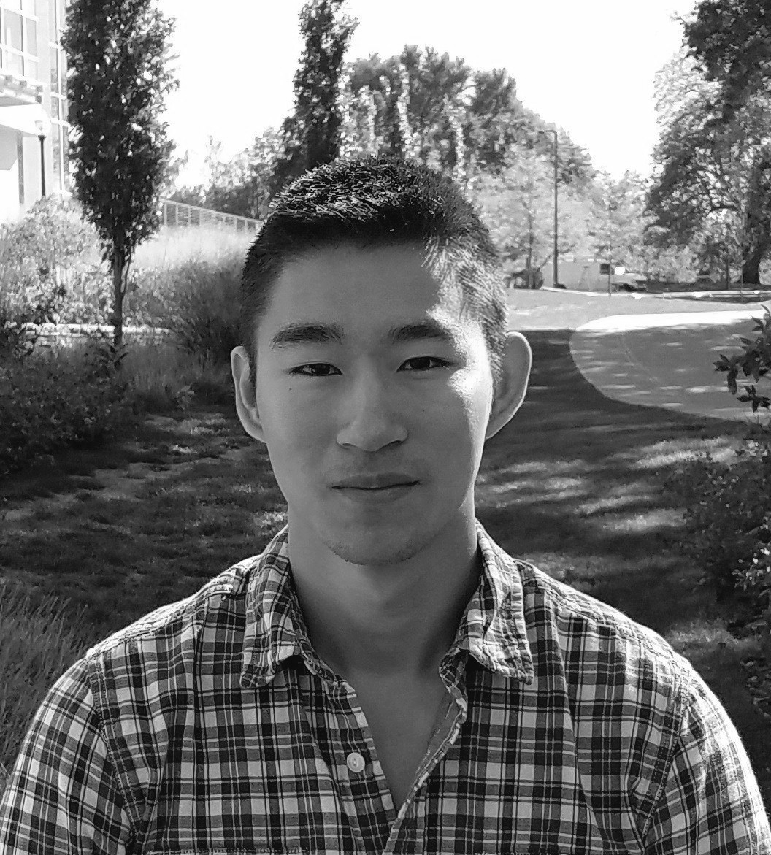
The Team
Sean Turner
EE
Michael Sheehan
EE
Jonathan Jamroga
CSE
Jonathan Yam
CSE

Slide 3
Mission Objective
Develop a single-room detection system that identifies where and when cell phone use occurs and allow the user to easily visualize and review detection events.
- Physically Non-invasive
- Eliminate manpower and human error
- Selective video evidence
- Ease of use

Slide 4
System Requirements
Accurate
- Localize detection at 40’ range to within ±5°
- <30 second sensor to GUI presentation latency
Easy to Use Presentation
- Real video feed with 2D heat map overlay
- User can playback stored events from times of detections
Operates on commercial cellular phone frequencies
- 850MHz for proof concept
- RF BPF on PCB to filter out undesired frequency bands

Slide 5
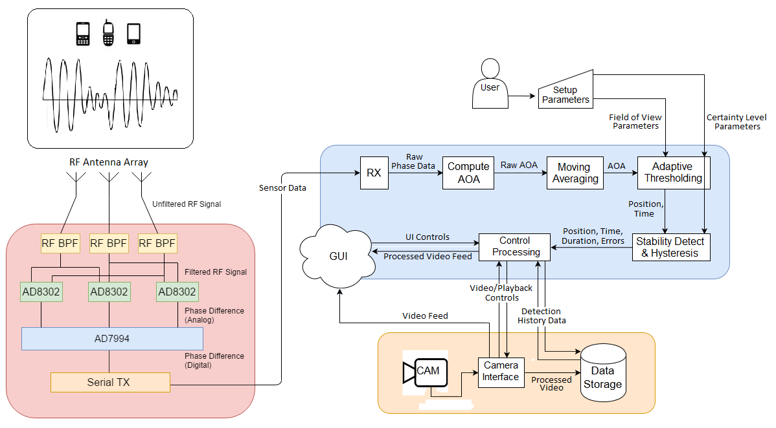
System Block Diagram

Slide 6
Proposed FPR Deliverables
Fully Integrated System
Full Antenna Array integrated
Camera integrated
GUI
Project Integrated with final enclosure

Slide 7
Current Status of FPR Deliverables
Fully Integrated System
Antenna array integrated with control board
Hardware communicating properly with processing block
All subsystems contained within final project housing
All systems effectively powered
Portable RF Beacon created and integrated into system for testing
Camera operational and mounted onto project housing
GUI compatible with PI and fully functional
Azimuths calculated consistently, accurately from AOA’s

Slide 8
Incomplete Deliverables
Antenna to antenna mutual coupling in the antenna array prevented a consistent, accurate azimuth calculation as initially expected. This is an issue that would have needed to be addressed by our initial design in order to be proficiently mitigated in our final implementation.
However, we have been able to record accurate readings for a single interferometer system (using each pair of antennas individually).

Slide 9
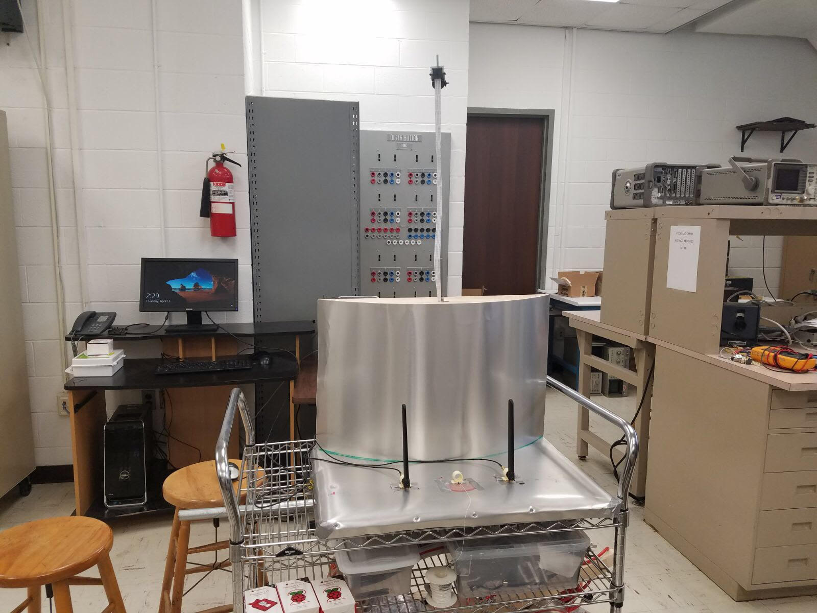
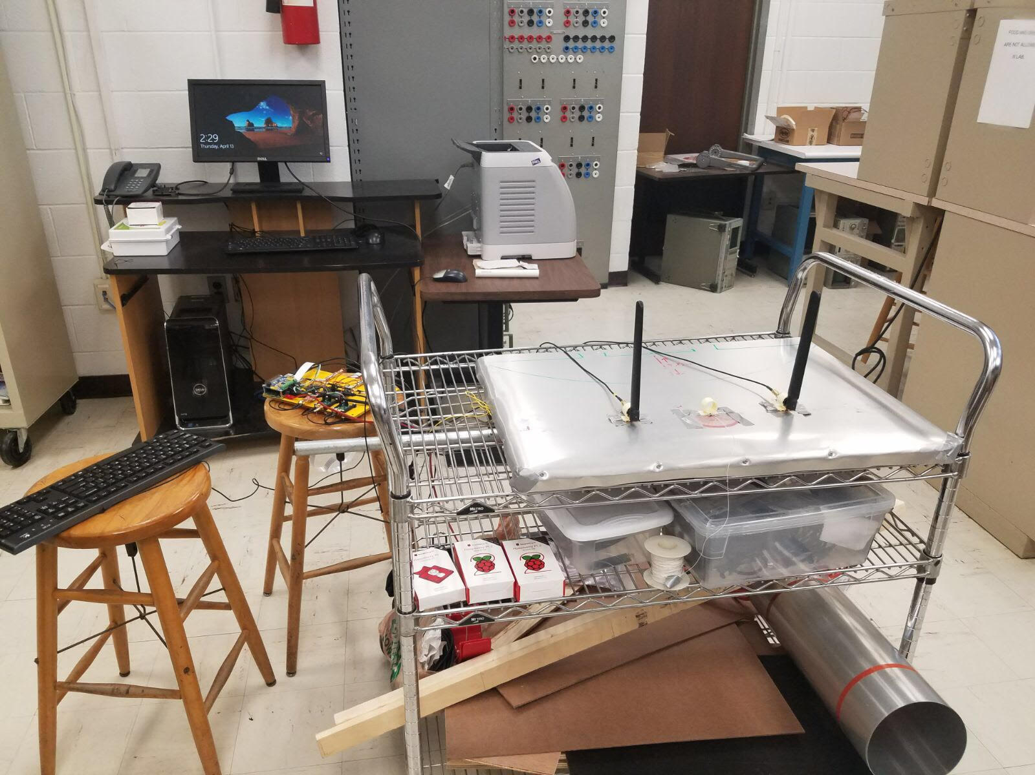
Experimental/Reevaluated System Concept

Slide 10
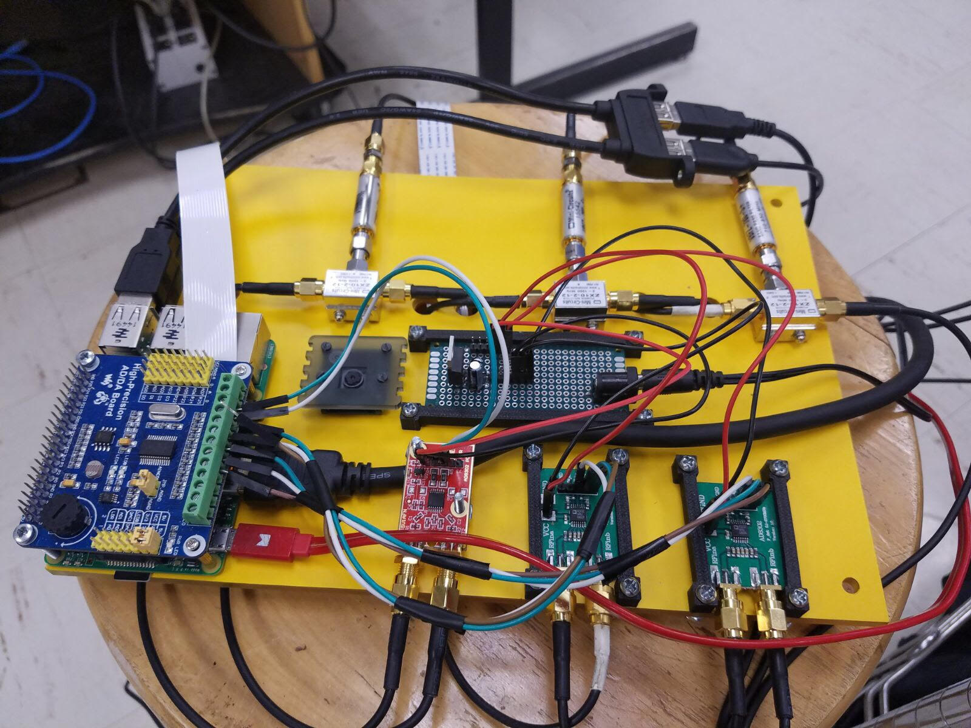
Control Board

Slide 11
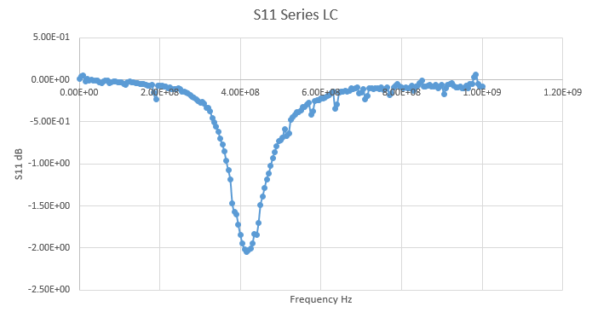
BPF Filter

Slide 12
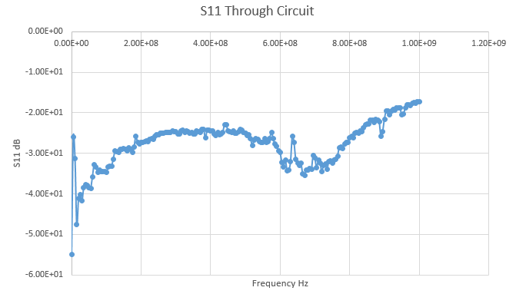
BPF Filter

Slide 13
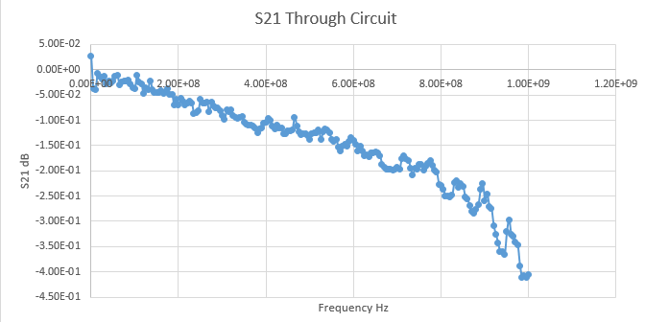
BPF Filter

Slide 14
Software Processing
Antenna→AD8302→ADC→Computer: 8 channel 4k+ sample/sec
Real-time △Phase→AoA calculation
DSP reliably distinguishes stable signals with low latency:
Moving-exponential averaging
Threshold stability detection
Hysteresis
1280x720 video recorded/processed efficiently after detections
GUI enables playback of video logs and detection data logs
Runs smoothly on Quad-Core 0.9 GHz, 1GB SDRAM

Slide 15
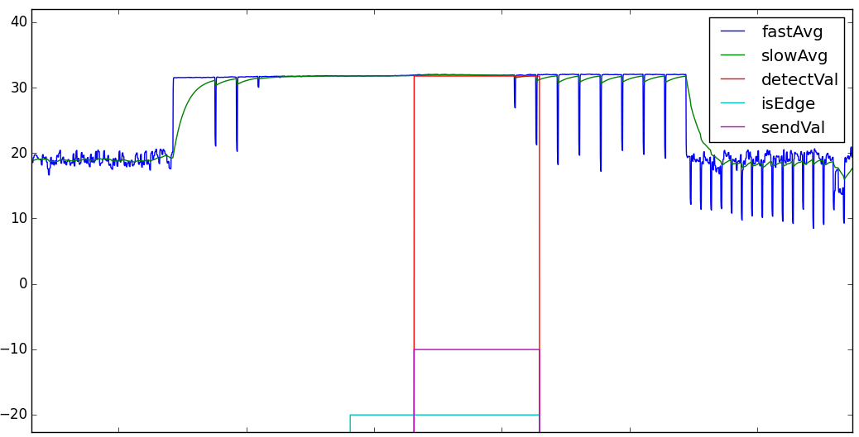
DSP

Slide 16
Usability
User configurable for certain environments
Room size
Noise level
Recording duration
Video quality
Adjustable camera
Portable
Powered off single wall outlet
Requires keyboard, mouse and display of choice

Slide 17
Command Line User Interface

Slide 18
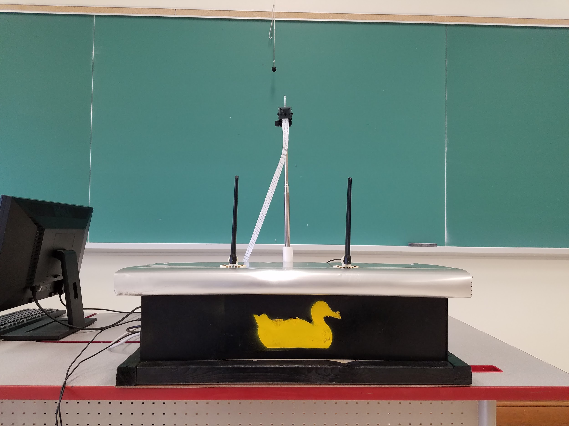
Redesign of Sitting Duck

Slide 19
System Requirements Realized
System Effectiveness
- Reliably detects signals transmitted at 868 MHz
- Real time detection response
Easy to Use Presentation
- Real video feed with 2D heat map overlay
- User can playback stored events from times of detections
Operates on commercial cellular phone frequencies
- 868 MHz operating frequency for RF beacon

Slide 20
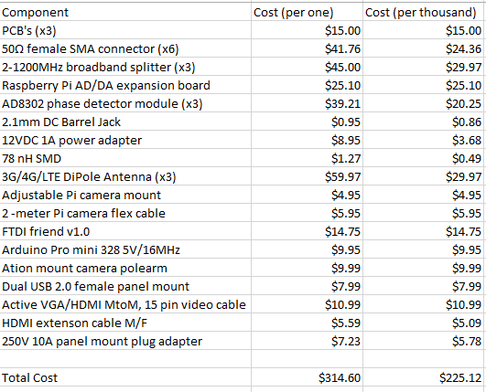
Final Cost Analysis

